Slide 1
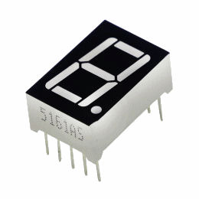
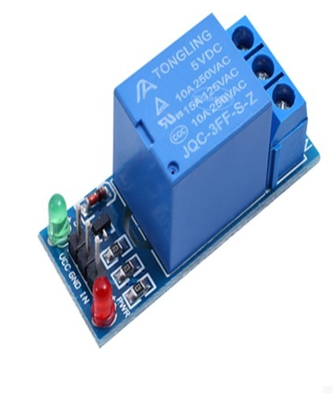
Arduino Session 9
Power Backup Lighting, relay
7-segment display

Slide 2
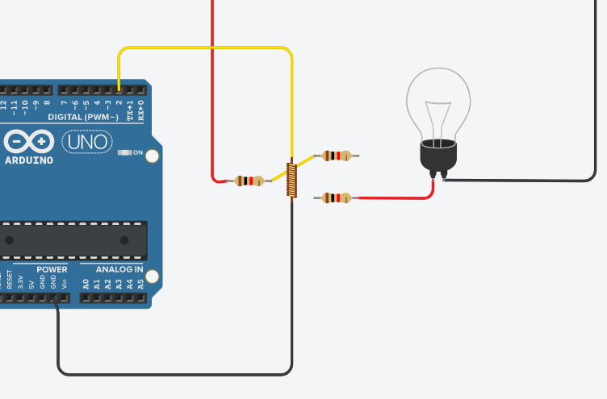
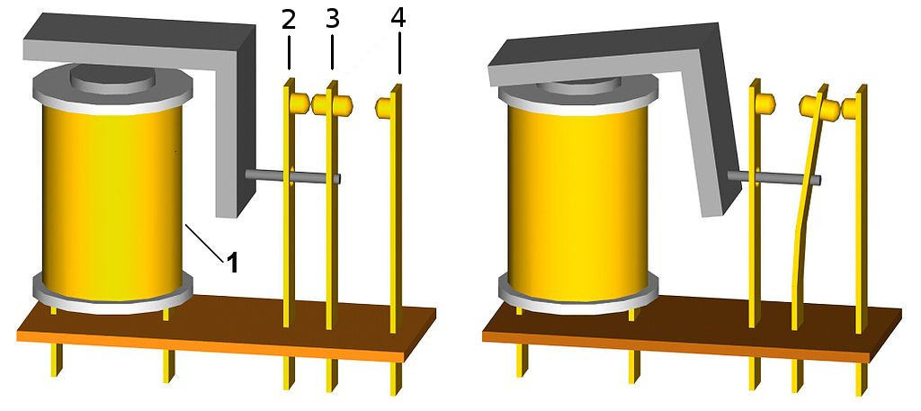
Relay Construction
2
3
4

Slide 3
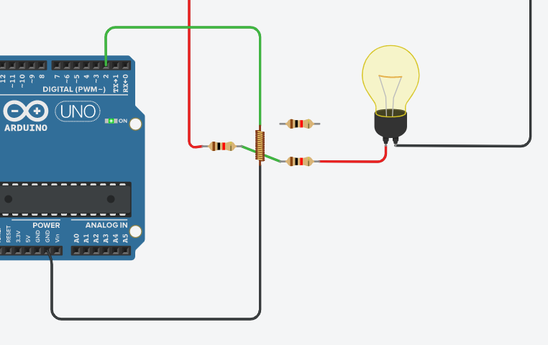
Relay Construction

Slide 4
Relay Interface
Open tinkercad.com

Slide 5
Power Backup Lighting
Connect the power supply to the light bulb through relay
Connect relay coil to the Arduino
Connect Mains Electricity indicator to Arduino
Write the code for backup lighting
Detect Low battery voltage

Slide 6
Other Forms of Electricity Mains Detection
Coil near isolated mains line
Photo sensitive resistor attached in front of power light indicator
Custom circuit to convert AC signal to appropriate DC signal

Slide 7
Assignment
Create an auto lamp that will light up when night falls (we know it is night by using photo sensitive resistor)

Slide 8
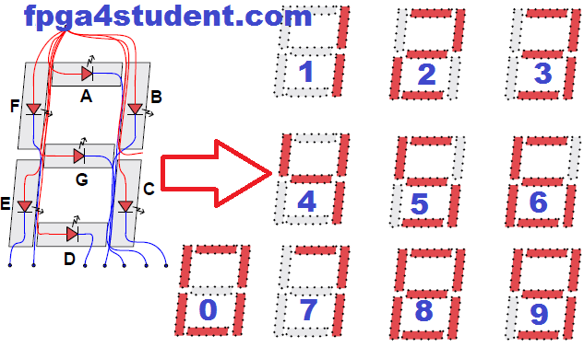
7-Segment Display

Slide 9
Types of Electrical 7-segment Display
Common Anode: all individual LED are controlled by providing them with current sink
Common Cathode: all individual LED are controlled by providing them with current source
Open tinkercad.com to see how to control LED from cathode and anode

Slide 10
How to interface Common Cathode 7-SD
Open tinkercad and connect each “positive” pin to a digital pin on the Arduino, ETC: 10min

Slide 11
How to Program 7-SD
We need to pull HIGH/LOW each pin according to the number we wish to display,
we either put 10 conditions for each number with their own set of outputs
or we can create array for desired output and loop through the pins changing their output state accordingly

